Slide 1


2023 ASIS&T
Webinar Series
March 30, 2023
“Critical Data Modeling (DCMI)”
webinars@asist.org

Slide 2
Critical data Modeling
Karen Wickett
School of Information Sciences
University of Illinois Urbana-Champaign
ASIST/DCMI Webinar
March 30, 2023

Slide 3
Critical Data Modeling
Using data modeling and systems analysis techniques to closely examine the creation and implementation of information systems
  to expose unjust or biased assumptions in data models or algorithms
  to highlight the technical roles of those assumptions within a system
Exposing and examining these assumptions in the language of the technical systems in which they are embedded will validate and expand existing critiques and enable the development of more equitable information systems.
Wickett, K. M. (2023). Critical data modeling and the basic representation model. Journal of the Association for Information Science and Technology, 1– 11. https://doi.org/10.1002/asi.24745

Slide 4
Why WE need Critical Data Modeling
Digital platforms are pervasive and the information representation decisions that structure those systems play out in the lives of our communities.
In Race After Technology (2019), Ruha Benjamin shows how information systems have created an insidious system of oppression obfuscated by the technical nature of the systems involved.
The complex relationships and layers of encodings involved in the realization of any digital object are an additional obfuscating factor for the analysis of modern information objects and systems.

Slide 5
Data Modeling
A data model is a set of labels for categories, and a set of assumptions about how those categories will be handled in a computational system.
Every information system uses data models to structure data and to specify processing.
Data modeling necessarily reduces real-world entities into the set of attributes defined by a data model.
Data modeling therefore takes a position on what matters about those entities by elevating some aspects and leaving others out.

Slide 6
The Basic Representation Model
A general model for information representation and encoding in digital objects.
An organizing framework for critical readings of datasets and systems
  Naming the entities and relationships involved at any level of representation or encoding
  Highlighting the interconnections between information representation choices at the various levels.

Slide 7
The Basic Representation Model
Expressions and encodings in various forms convey propositional content to some audience.
  The content of a class roster could be expressed as a table of data, an XML document, or a series of sentences in natural language
Symbol structures express semantic content in some context or encode other symbol structures within a computational system.
  layers of encoding and representation in a digital system are by a series of is Encoded By relationships between Symbol Structures.
We are material beings in a material world, we encounter information via patterned matter or energy that carries the inscription of symbol structures

Slide 8
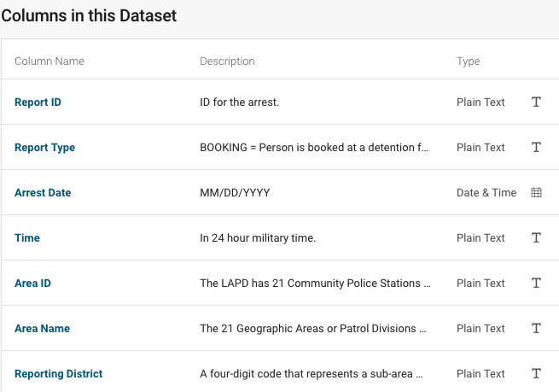
Modeling A police Arrest Record Dataset
Examples from an ongoing critical reading of the “Arrest Data from 2020 to Present” dataset published through the Los Angeles Open Data platform.
Close readings of the dataset versions and data model documentation.
  Metadata for the entire dataset and a table that describes each of the 25 columns of data provided in the dataset.
  Structured queries designed around reading the metadata.

Slide 9
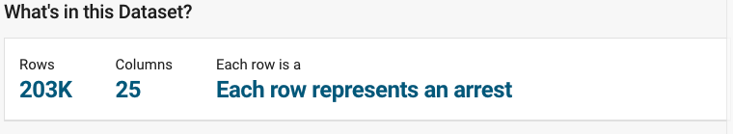
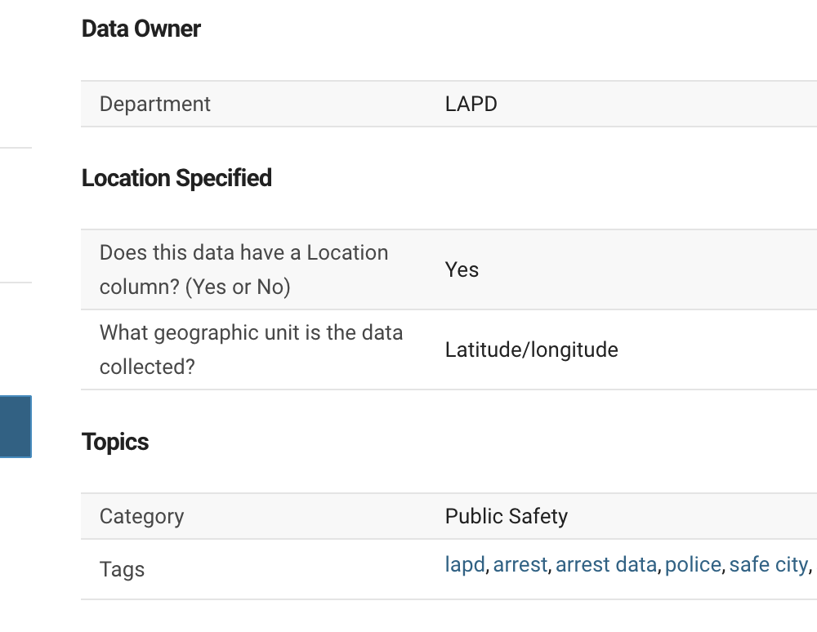
Counting rows as crimes
Arrests are the primary entity in the dataset.
There is an assumed correspondence between a row in the dataset and a criminal incident.
Location information in the dataset reflects location of a criminal incident associated with an arrest, not the location where the arrest occurred.

Slide 10
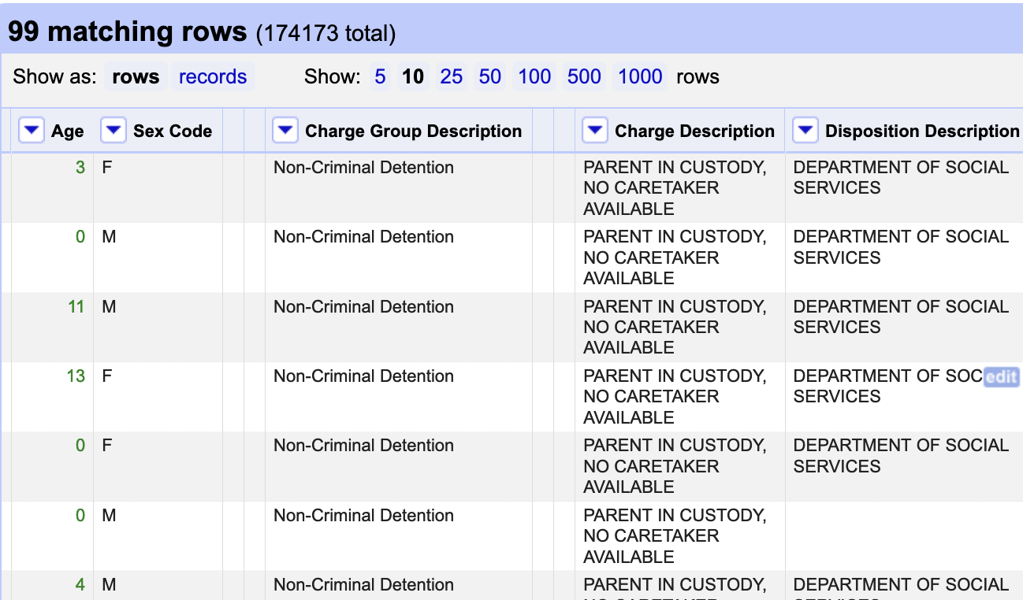
Counting Rows as Crimes
Some rows do not correspond to suspected criminal activity of the person described by that row.
Filtering the dataset for the value “PARENT IN CUSTODY, NO CARETAKER AVAILABLE” in Charge Description gives 99 rows, all with Age values between 0 and 17.
  These rows represent children taken into custody by the LAPD when one or both of their parents were arrested.

Slide 11
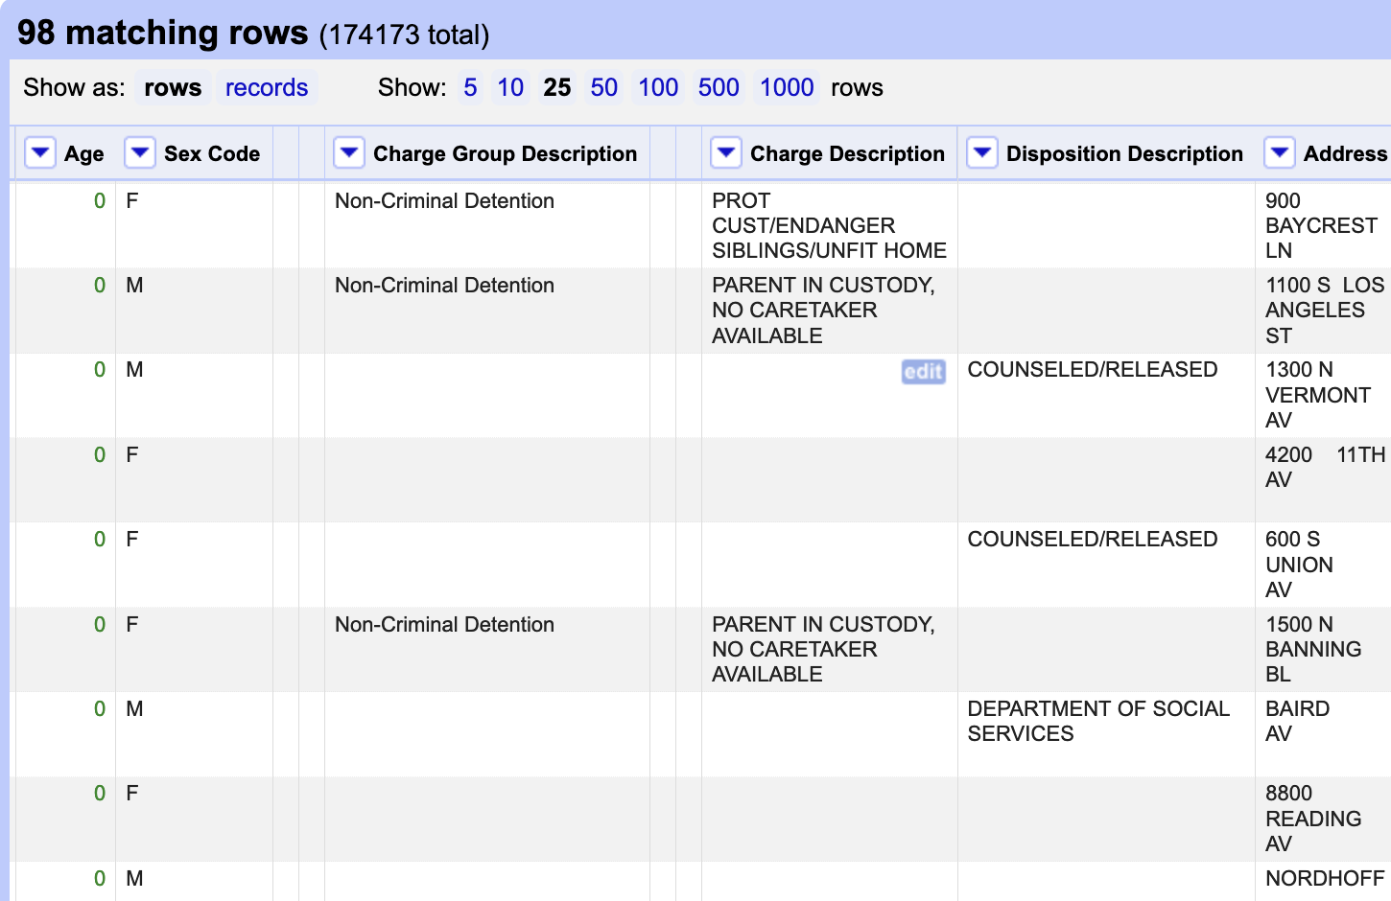
Counting Rows as Crimes
Rows for children in the Arrest Dataset have a tendency for sparseness but still have location information.
  66 of the 98 rows with Age of 0 have no Charge Description listed
  Only 2 of the 98 rows with Age of 0 have location as (0,0), which indicates missing data
  96 rows list a latitude and longitude for location

Slide 12
Attributes Foreground location
10 of the 25 available attributes offer information about geographic location, at varying levels of granularity
  Area ID, Area Name, Reporting District, Address, Cross Street, LAT, LON, Location, Booking Location, Booking Location Code.

Slide 13
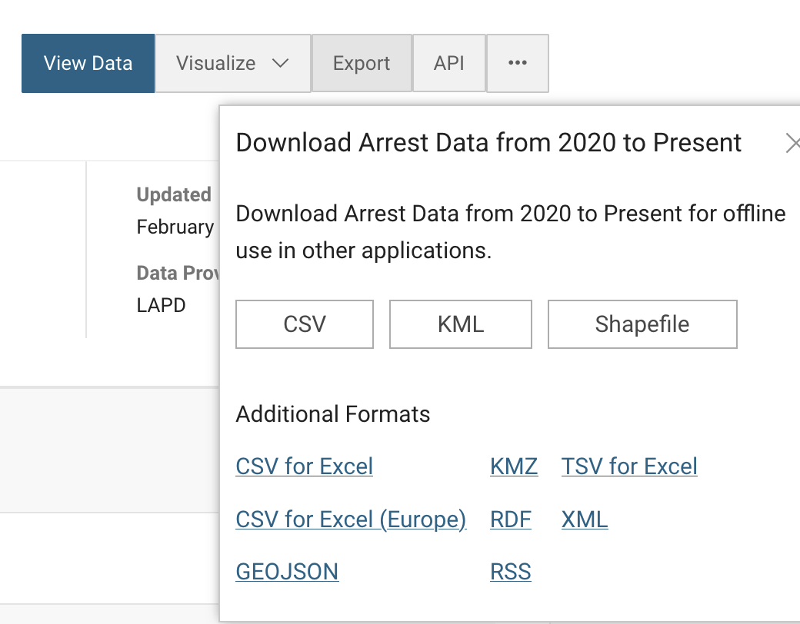
Export Formats foreground location
There are three main formats for downloading the Arrest Dataset:
  CSV, KML, and Shapefile.
  KML and Shapefile are both geographic data formats
The dataset is positioned as geographic information.
Criminal justice systems transform information into geographic information.
This has a significant impact on how we understand places and people in our communities (Jefferson, 2020).

Slide 14
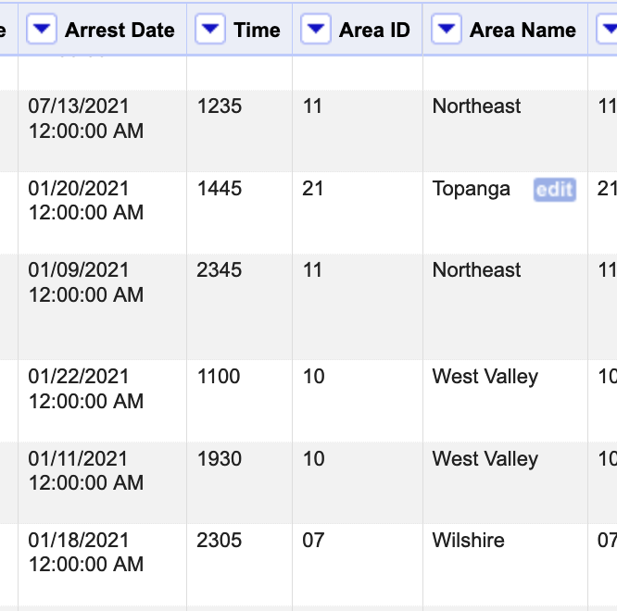
Datatype over Accuracy - Time
Arrest Date and Booking Date use the Floating Timestamp datatype.
To conform with the datatype, values for this attribute must include a time, not just a date.
Every time value listed for Arrest Date and Booking Date is “12:00:00 AM”
Other attributes give times with a distribution of values that suggest that they are accurate transcriptions from the original arrest record
  Time corresponds with Arrest Date
  Booking Time corresponds with Booking Date

Slide 15
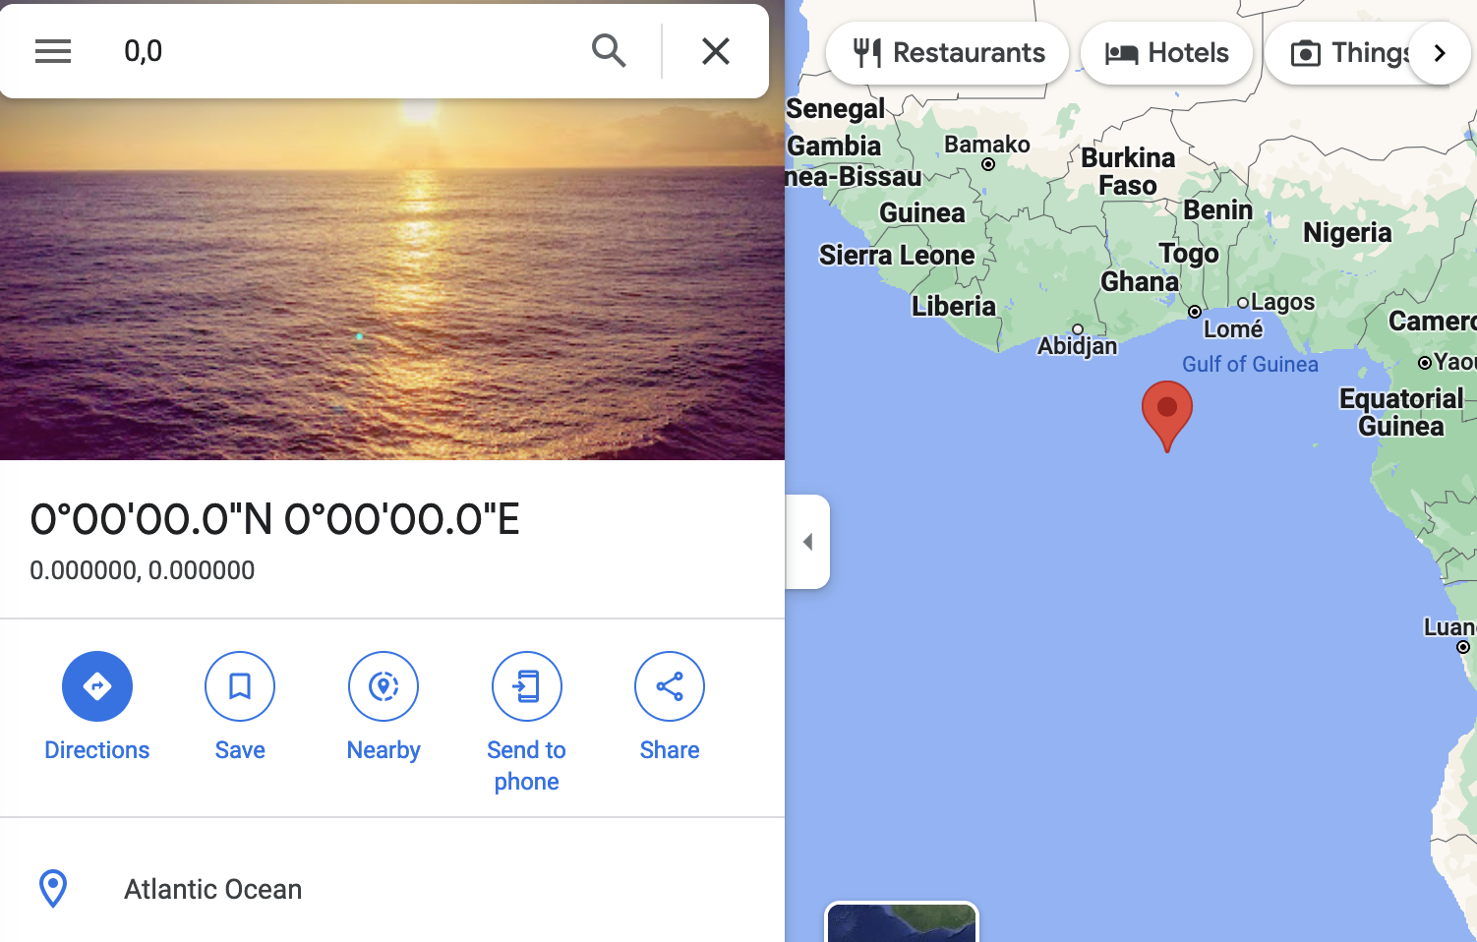
Datatype over accuracy - location
The dataset summary states, “Some location fields with missing data are noted as (0.0000°, 0.0000°).” But this is an actual location.
This point appears in 4640 number of rows in the dataset.
Every row in the dataset has a value for Location that matches the Point datatype, even in rows that were missing location data in the original arrest record.
Maintaining conformance with the datatype has taken precedence over accuracy of the data.
  Awareness of levels of representation and interactions between lets us analyze these cases

Slide 16
Conclusions
Information science is called as a field to examine the ways in which social injustices are built into our information systems through data models.
Critical data modeling is a method for analyzing data models and existing data objects in order to examine the sociotechnical commitments, underlying assumptions, and social and cultural consequences of information systems.
The Basic Representation Model provides a logical framework for a critical interrogation of an information object.

Slide 17


THANK YOU FOR ATTENDING
Submit a webinar proposal at https://www.asist.org/meetings-events/webinars/
webinars@asist.org
A copy of the recording and a follow-up survey will be emailed within 24 hours.

