Slide 1



2022 ASIS&T Webinar Series September 15, 2022 “Querying Wikidata: All the Knowledge in the World (DCMI)”
Daniel Garijo, Ontology Engineering Group,
Universidad Politécnica de Madrid, Spain
Heavily based on the K-CAP 2019 Tutorial “Linking, Extending, Exploiting and Enhancing Tabular Data with Wikidata” (with Pedro Szekely)
@dgarijov
webinars@asist.org

Slide 2
Contents
A brief introduction to Wikidata
What is Wikidata?
The Wikidata Data model
Organizing data in Wikidata (Wikidata schema)
Querying Wikidata with SPARQL
Summary

Slide 3

Goals of the Wikidata Project

Slide 4
What is Wikidata? Project Goals
Wikidata (https://wikidata.org/) is a free, collaborative, multilingual, secondary database, collecting structured data to provide support for Wikipedia, Wikimedia Commons, the other wikis of the Wikimedia movement, and to anyone in the world.
https://www.wikidata.org/wiki/Wikidata:Introduction

Slide 5
Why I ❤ Wikidata
Free
The data in Wikidata is published under the Creative Commons Public Domain Dedication 1.0.
Collaborative
Data is entered and maintained by Wikidata editors, who decide on the rules of content creation and management. Automated bots also enter data into Wikidata.
Multilingual
Editing, consuming, browsing, and reusing the data is fully multilingual. Data entered in any language is immediately available in all other languages.
A secondary database
Wikidata records not just statements, but also their sources, and connections to other databases.
Collecting structured data
Imposing a high degree of structured organization allows for easy reuse of data by Wikimedia projects and third parties, and enables computers to process and “understand” it.
Support for Wikimedia wikis
Wikidata assists Wikipedia with more easily maintainable information boxes and links to other languages.
Anyone in the world
Anyone can use Wikidata for any number of different ways by using its application programming interface, the SPARQL endpoint and the JSON and RDF dumps.

Slide 6
Why Wikidata?

Slide 7
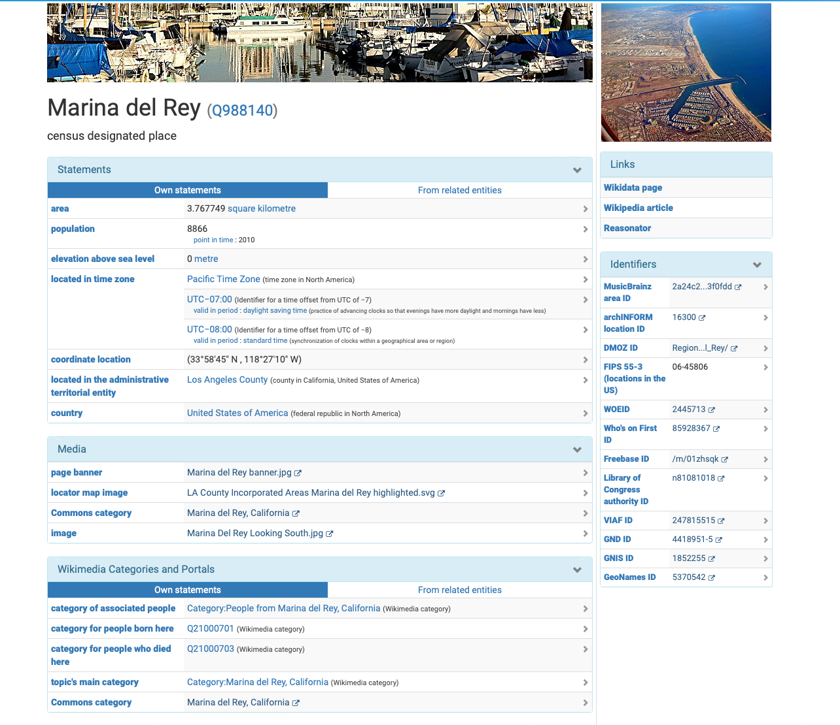
Why Wikidata?
Good data
LOTS of data:
> 99M items
> 6,000 properties
> 2,000,000 classes
> 4,000 external id types
qualifiers
external identifiers

Slide 8
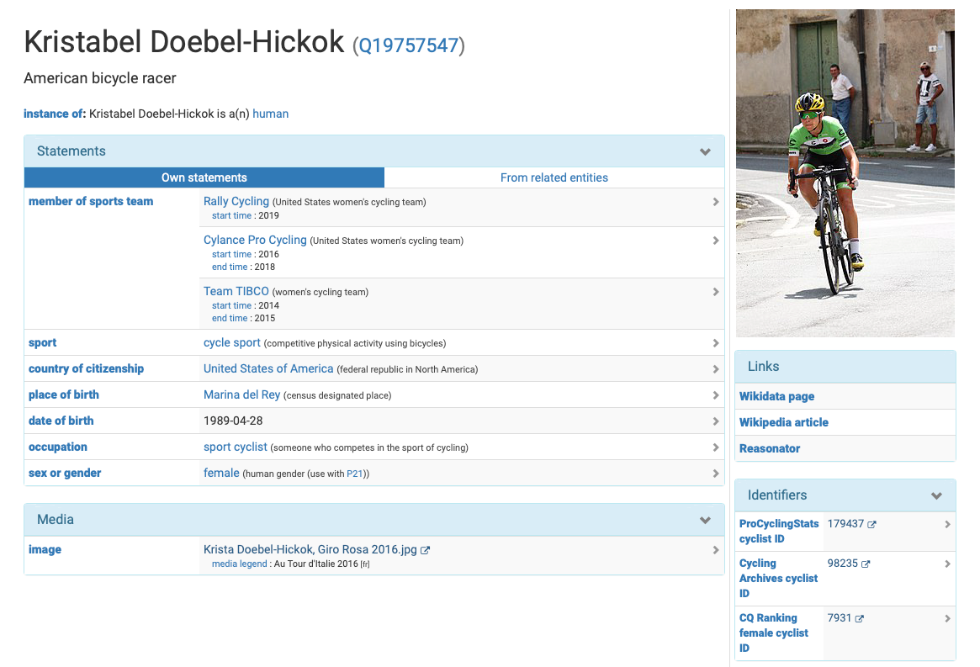
More data than other KGs!

Slide 9
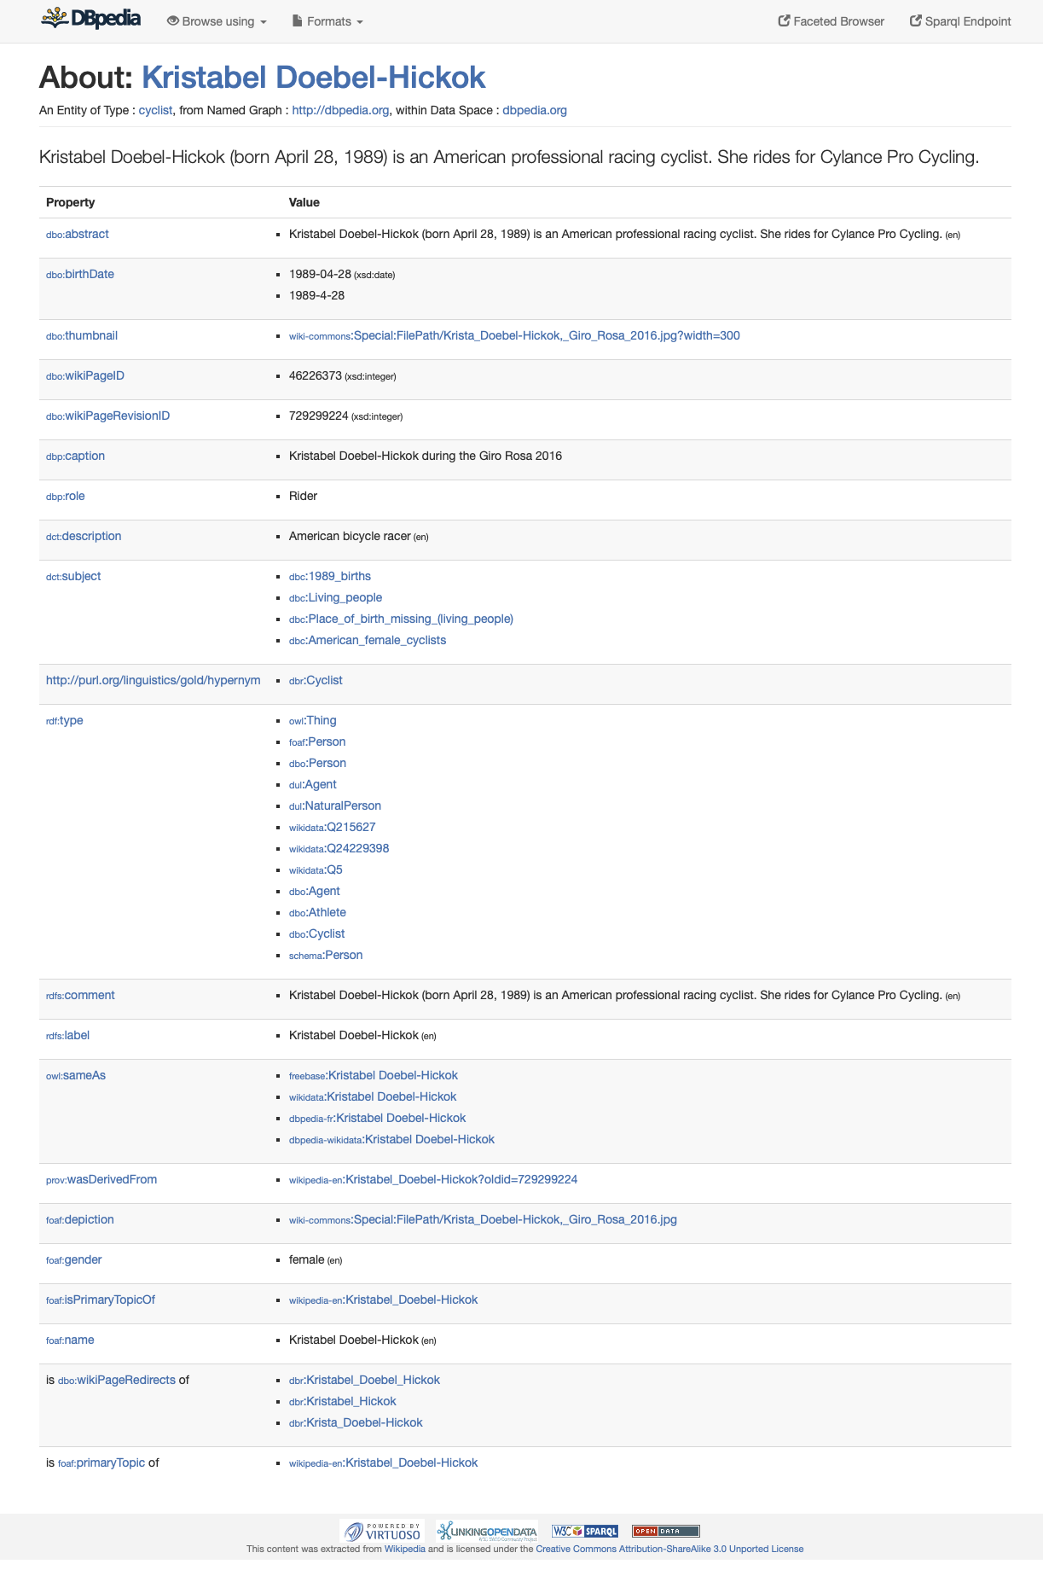
More data than other KGs!
no sport team, no identifiers

Slide 10
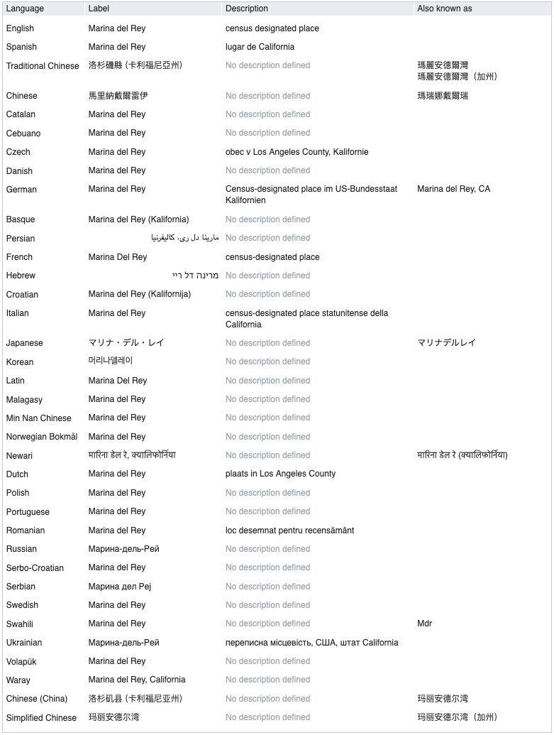
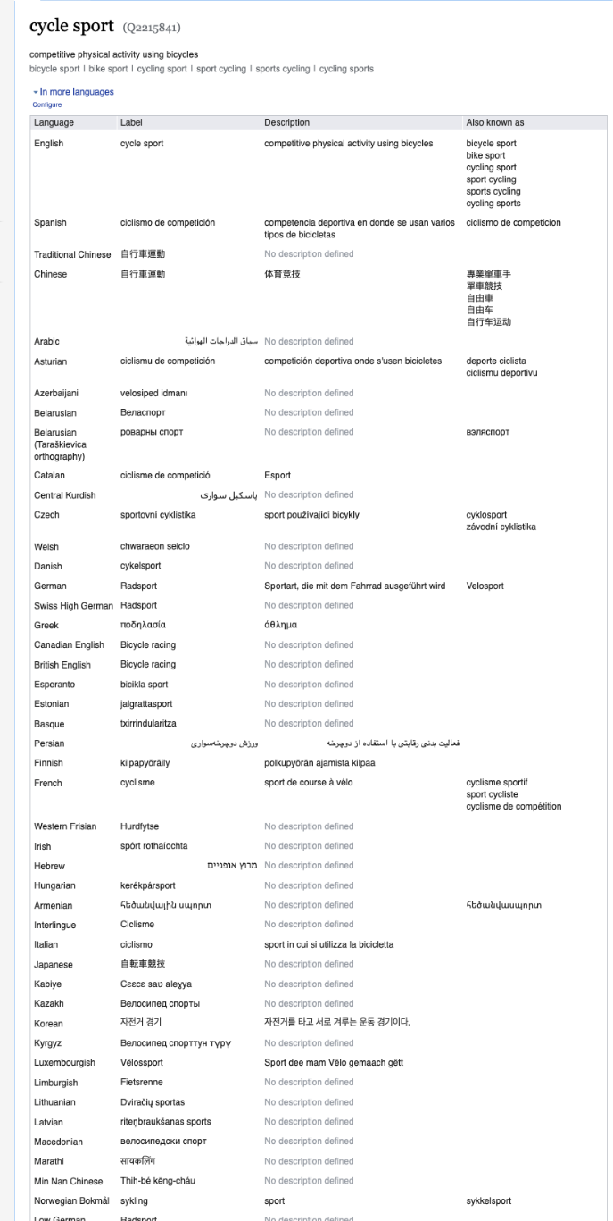
Wikidata is multilingual
Descriptions and labels available in multiple languages
same id is used for all languages!

Slide 11
The Wikidata data model

Slide 12
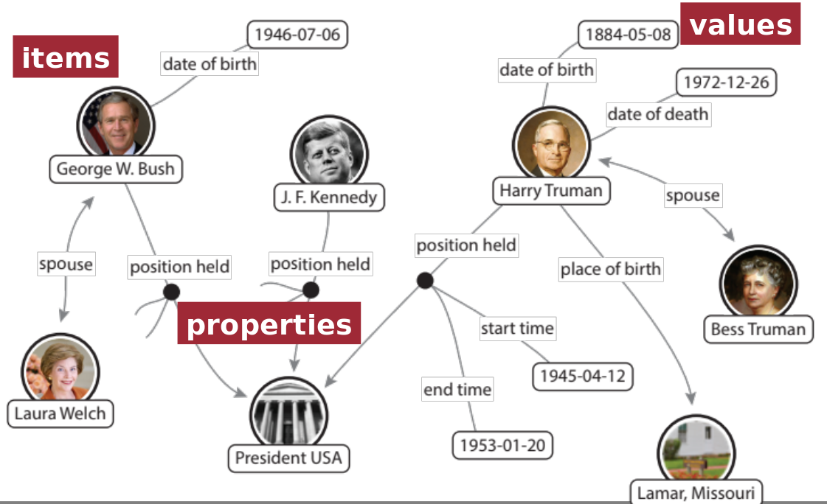
Wikidata represents entities in a Knowledge Graph

Slide 13
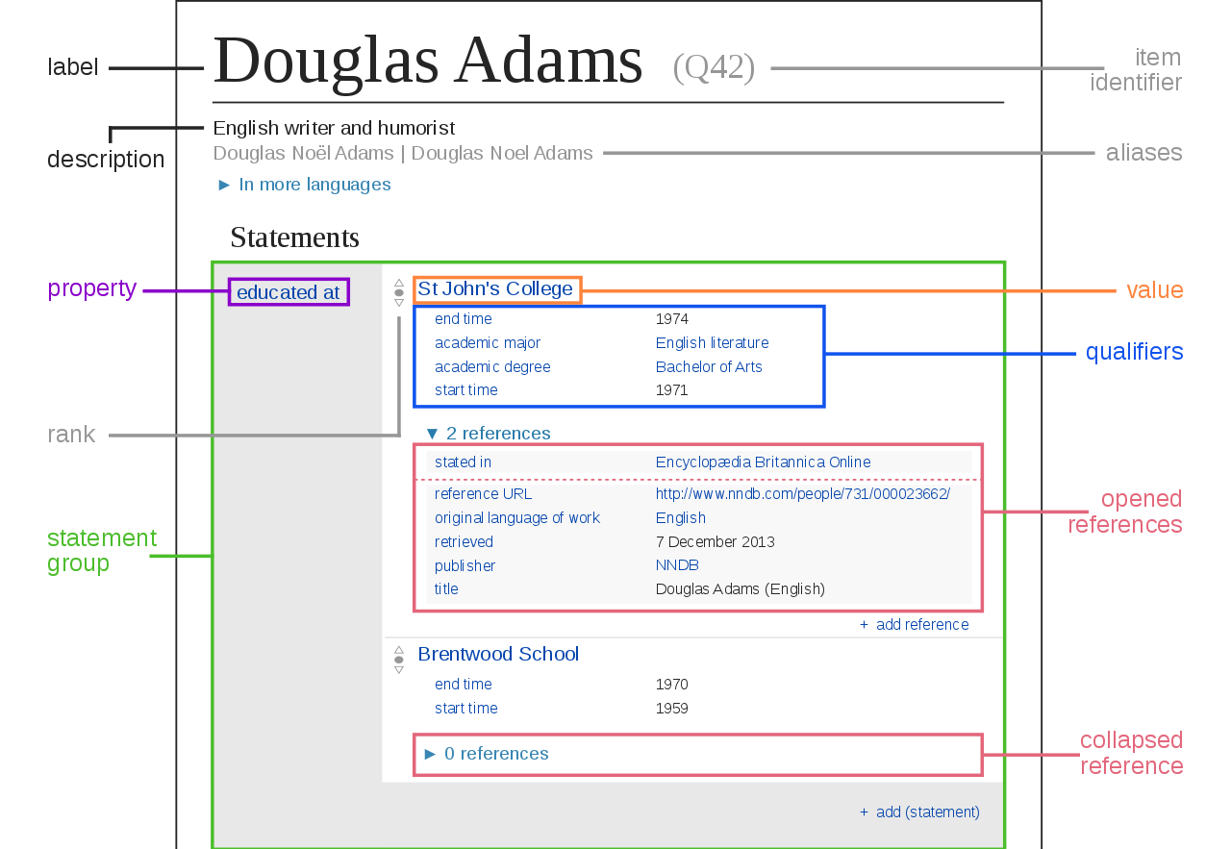
Wikidata Data model

Slide 14
Identifiers (QNodes) and labels

Slide 15
Aliases and multilingual descriptions

Slide 16
Triples: subject, predicate, object
subject
predicate (property)
object (value)

Slide 17
Qualifiers (additional context about a triple)
Qualifier property
Qualifier value
Notes:
What is the qualifier subject?

Slide 18
References and ranks
Ranks can be:
Preferred
Normal
Deprecated
Notes:
What is the qualifier subject?

Slide 19
Organizing data in Wikidata (Wikidata schema)

Slide 20
Crowdsourced ontology
P31

Slide 21
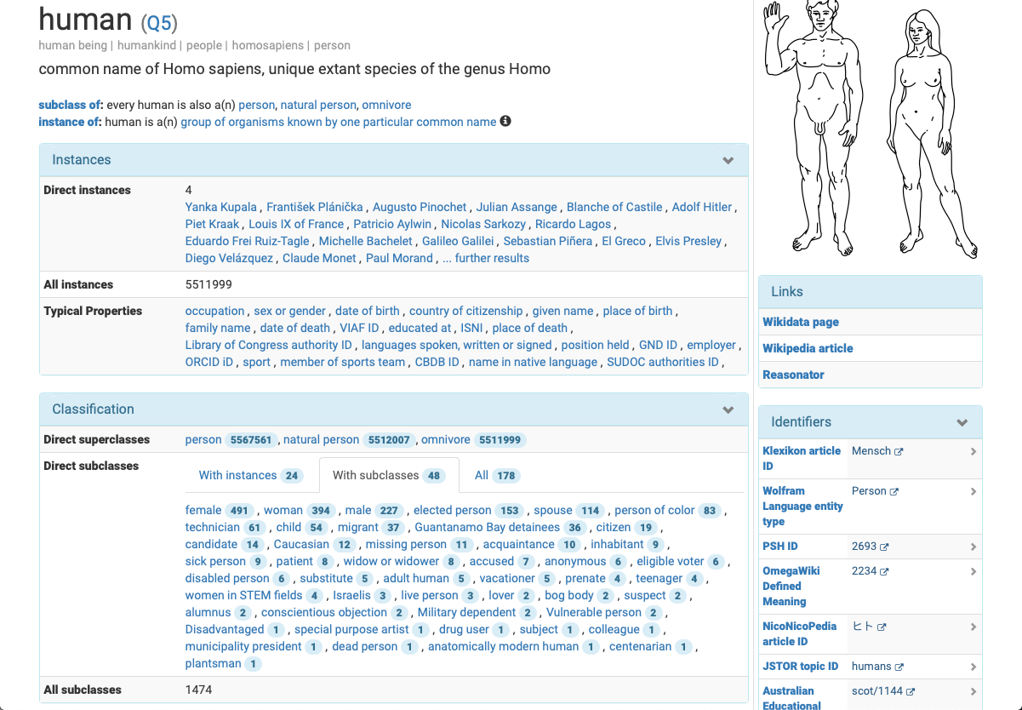
Looking at classes (P279)...
Classes are items
They can be instances and subclasses at the same time!

Slide 22
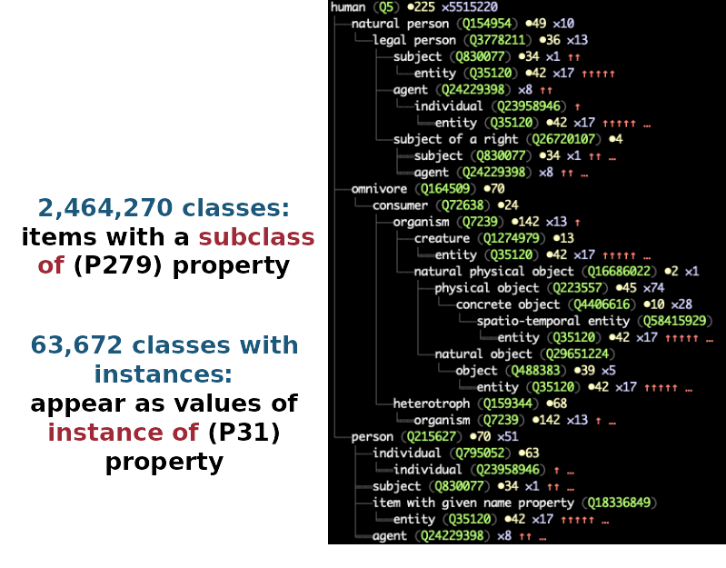
A very large class hierarchy

Slide 23
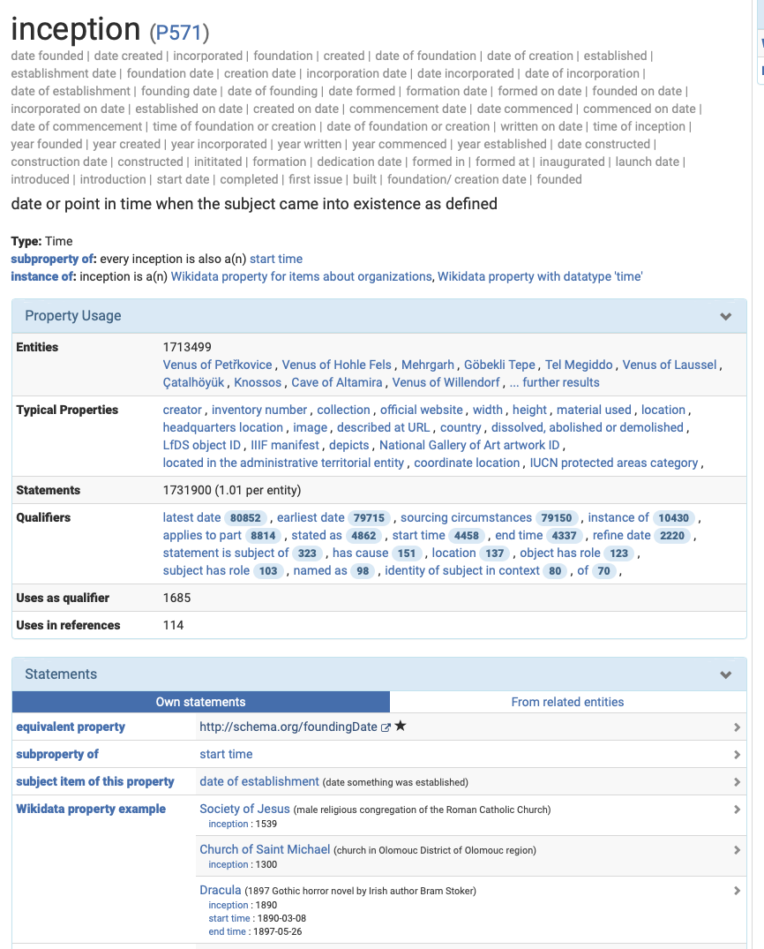
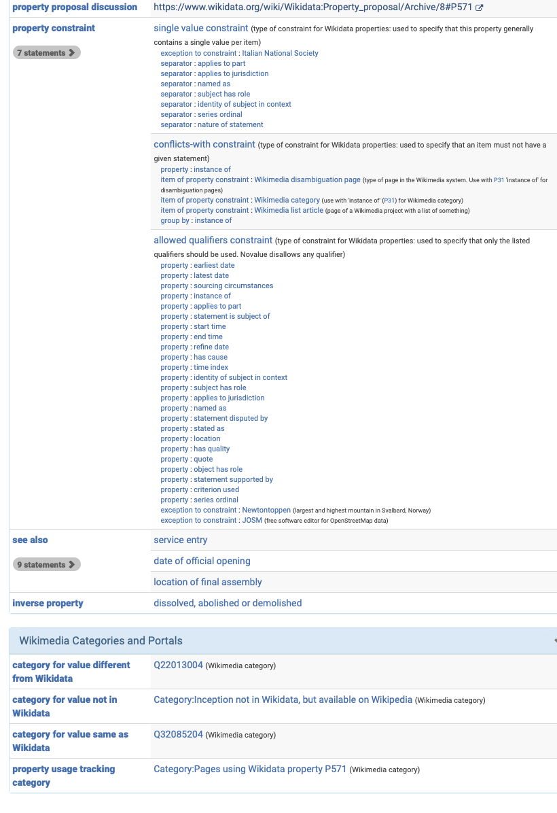
About properties ...

Slide 24
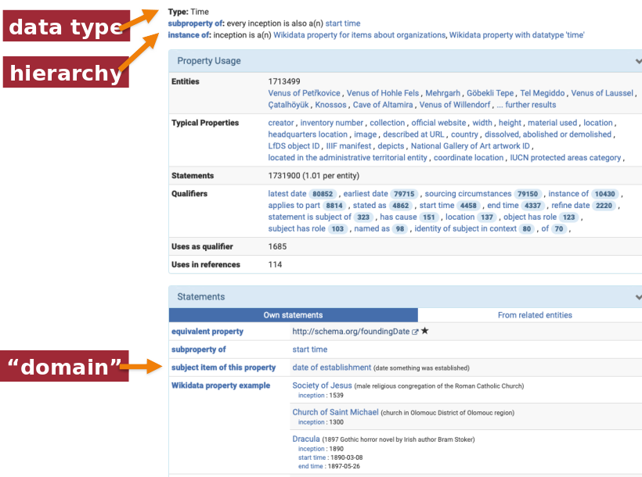
Property types

Slide 25
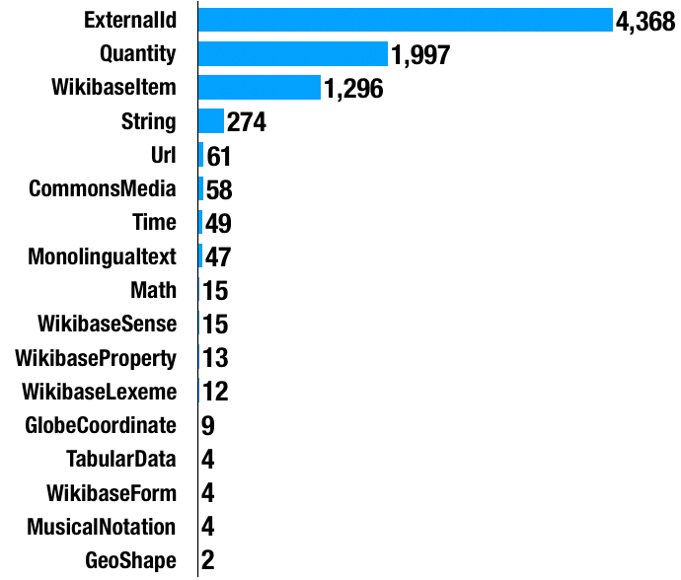
Properties by type

Slide 26
Modeling data in Wikidata in practice

Slide 27
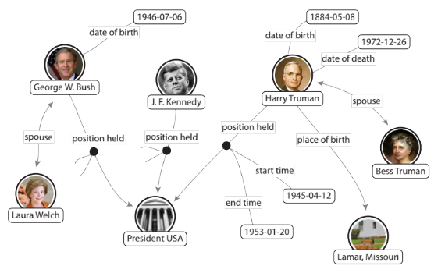
We usually represent graphs with triples
Subject
Property
Value
How to represent qualifiers?

Slide 28
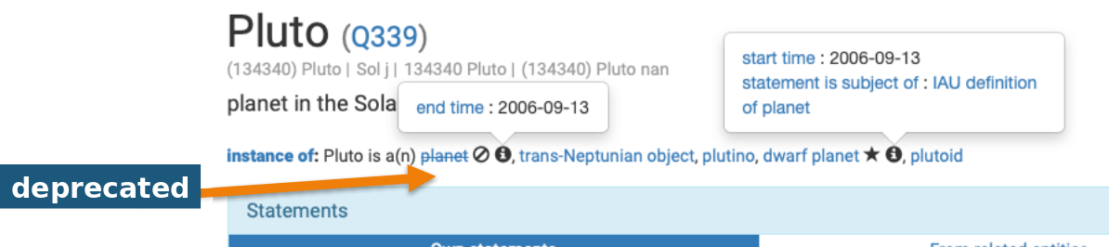
How do we represent qualifiers, references and deprecated statements?
Example: is Pluto a planet?
Until 2006, it was considered a planet
After 2006, it is considered a trans-neptunian object
In Wikidata, this is represented as follows:

Slide 29
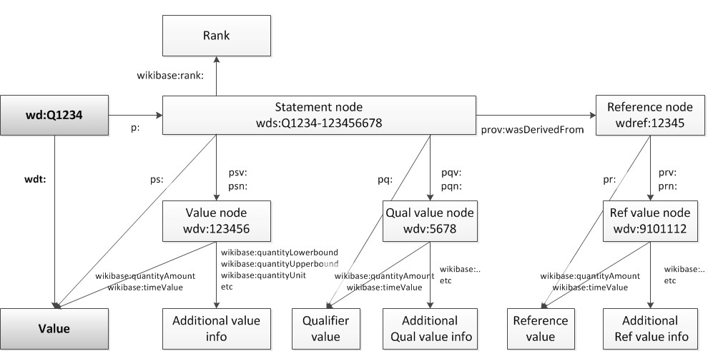
Reification!
Rank, qualifiers, references
Subject
Property

Slide 30
Querying Wikidata with SPARQL

Slide 31
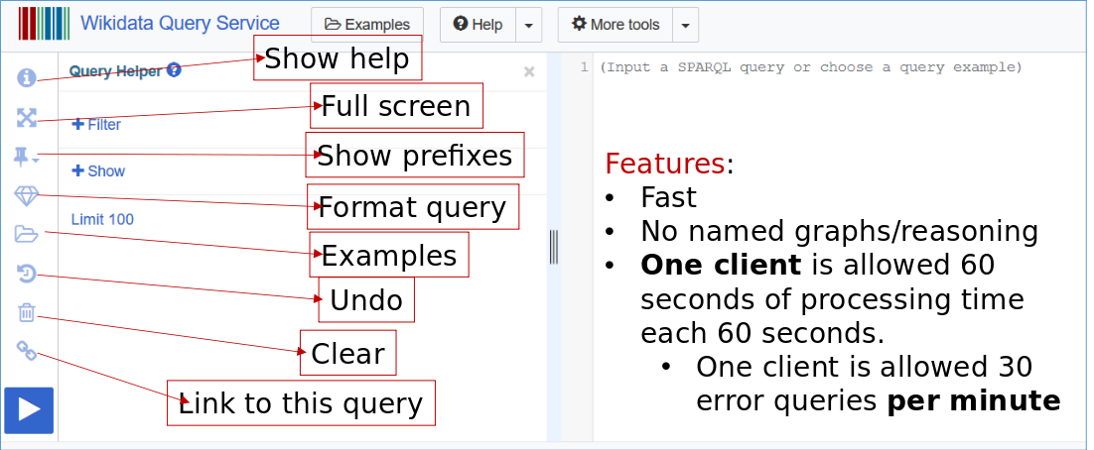
Wikidata SPARQL endpoint
https://query.wikidata.org
Having trouble with a query? Request it: https://www.wikidata.org/wiki/Wikidata:Request_a_query

Slide 32
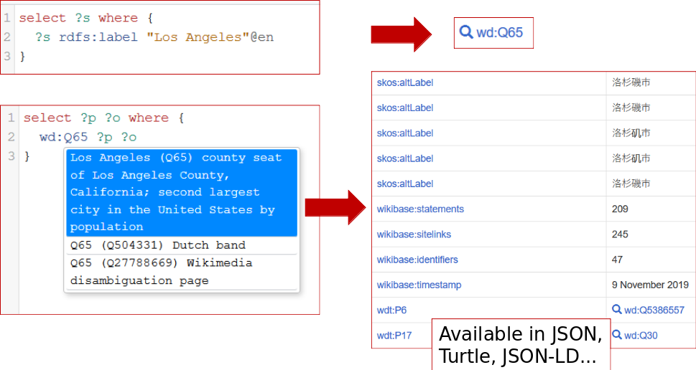
SPARQL help: autocompletion
More information: https://www.wikidata.org/wiki/Wikidata:SPARQL_query_service/A_gentle_introduction_to_the_Wikidata_Query_Service

Slide 33

Before you start
Bear in mind that in Wikidata:
Everything is an entity (classes, properties, instances)
rdf:type -> P31
rdfs:subClassOf -> P279
rdfs:domain and rdfs:range are type constraint (type and value type constraints)

Slide 34
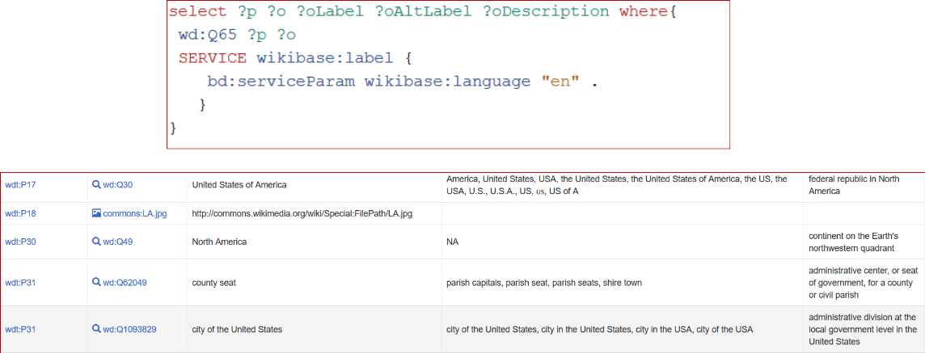
Query service: special features
Functionality designed to facilitate recovering basic resource metadata

Slide 35
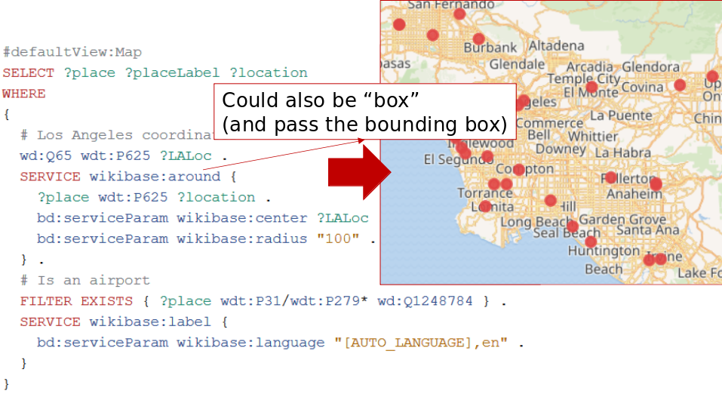
Query service: advanced special features
Geospatial search (may be slow)
More info: https://www.mediawiki.org/wiki/Wikidata_Query_Service/User_Manual

Slide 36
Going back to our cheatsheet

Slide 37
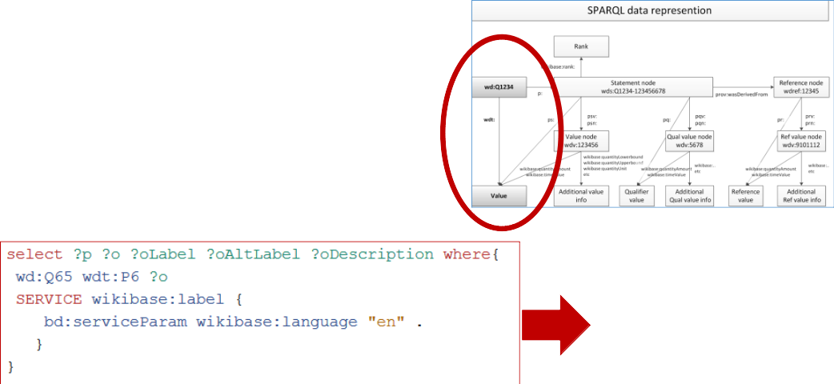

Example: Exploring simple facts
Who is the governor in LA?
Link to query: https://w.wiki/CFf

Slide 38
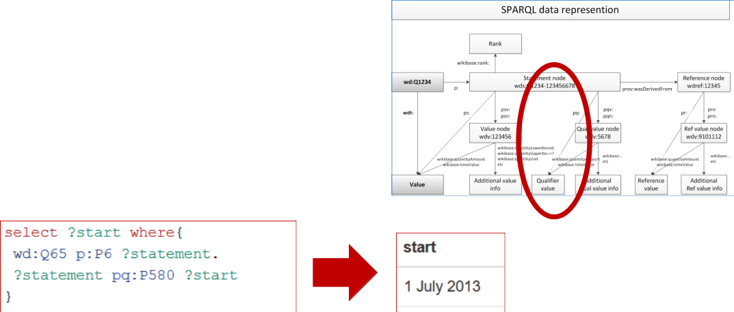
Extracting information from qualifiers
How long has the governor been in office?
Link to query: https://w.wiki/CFh

Slide 39
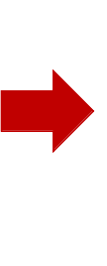
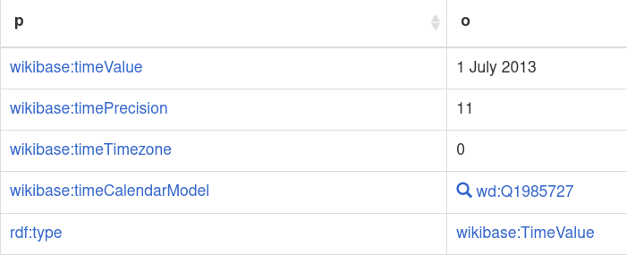
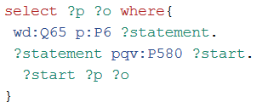
Extracting additional qualifier information
What if we want to know more about how the qualifier value has been represented?
For example, what is the time precision used in the previous start date?
Link to query: https://w.wiki/CFj

Slide 40
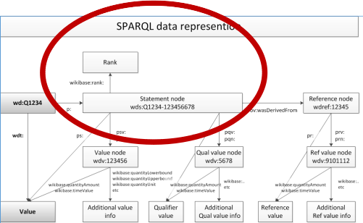
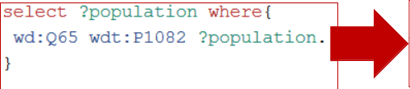

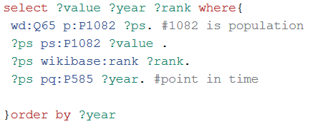
Truthy statements
Let’s now review the population in LA
This returns a single result, which corresponds to the “truthy” statement (first rank). In Wikidata, the truthy statement for population is set to the latest available year:
Link to queries: https://w.wiki/5gKZ, https://w.wiki/5gKa

Slide 41
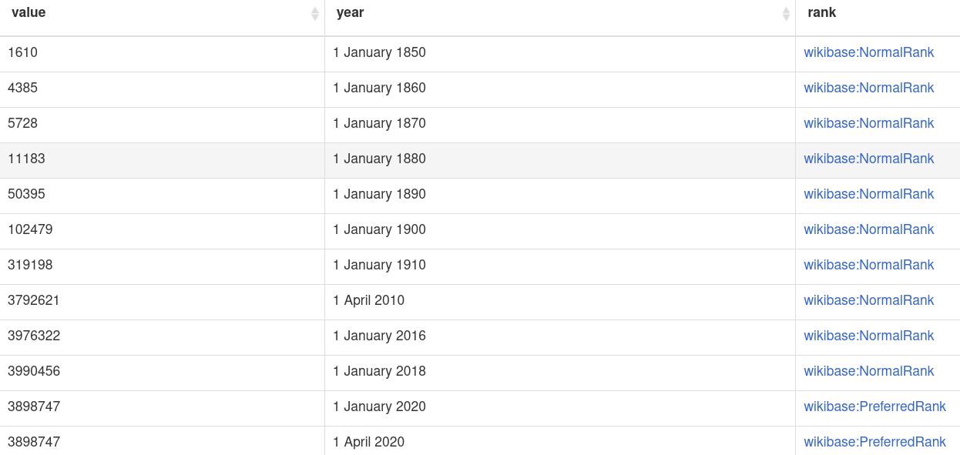
Truthy statements: results

Slide 42
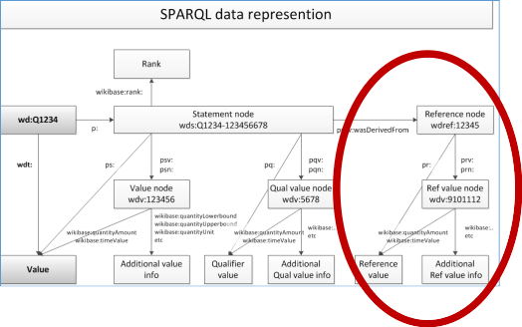
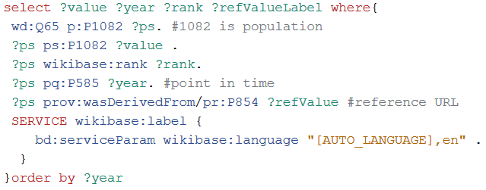
References
What is the source for each triple regarding the population in LA?
Link to query: https://w.wiki/CFo

Slide 43
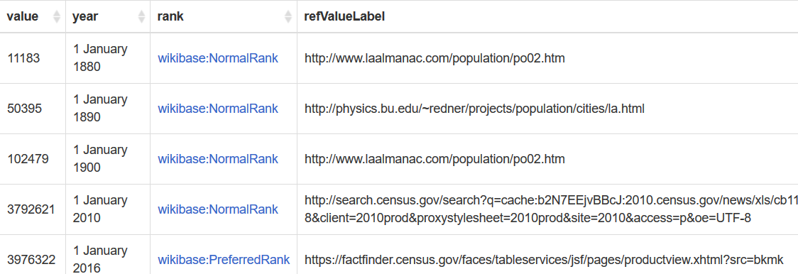
References: results

Slide 44

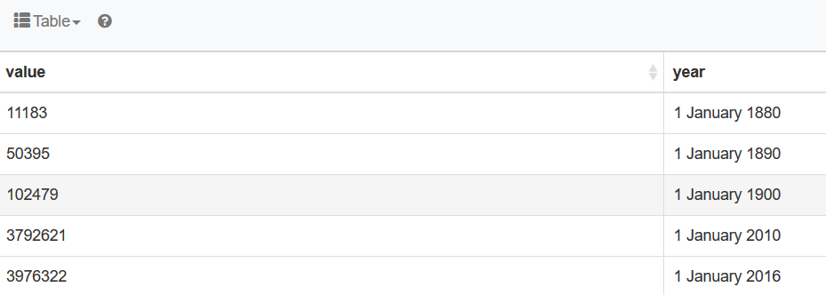
Using SPARQL to plot results
Population of LA by year

Slide 45
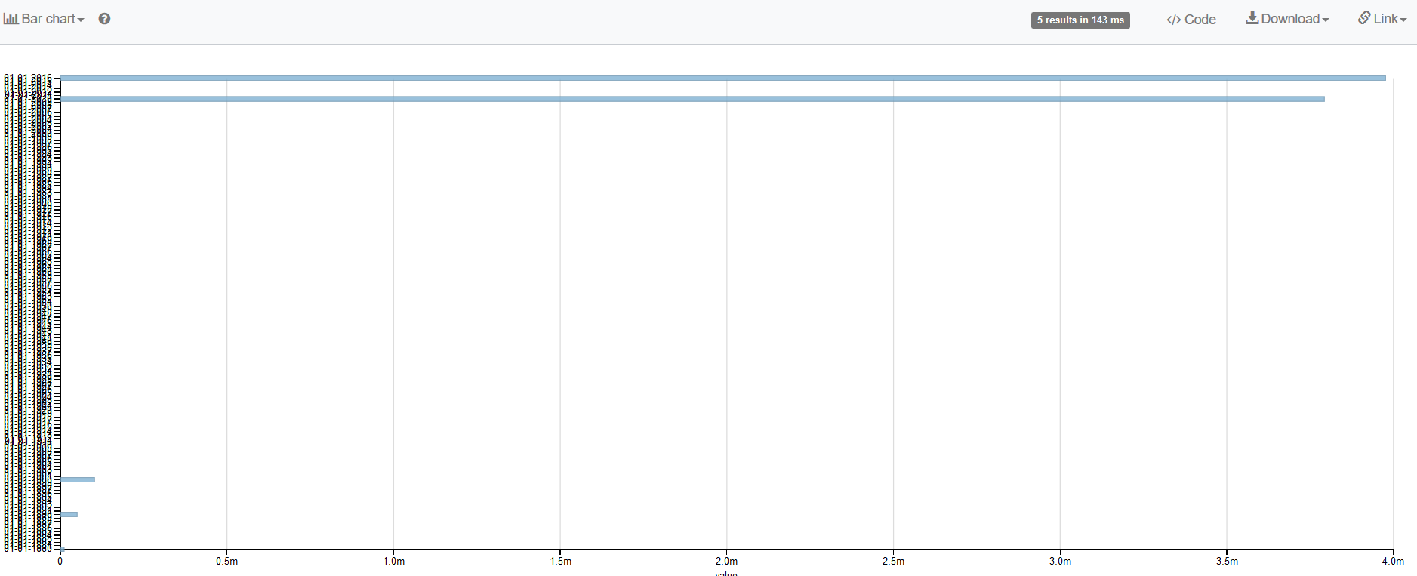
Using SPARQL to plot results

Slide 46
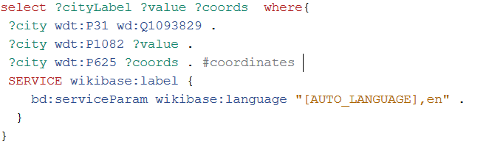
Geospatial queries
Population for all cities in the US
Link to query: https://w.wiki/CFy

Slide 47
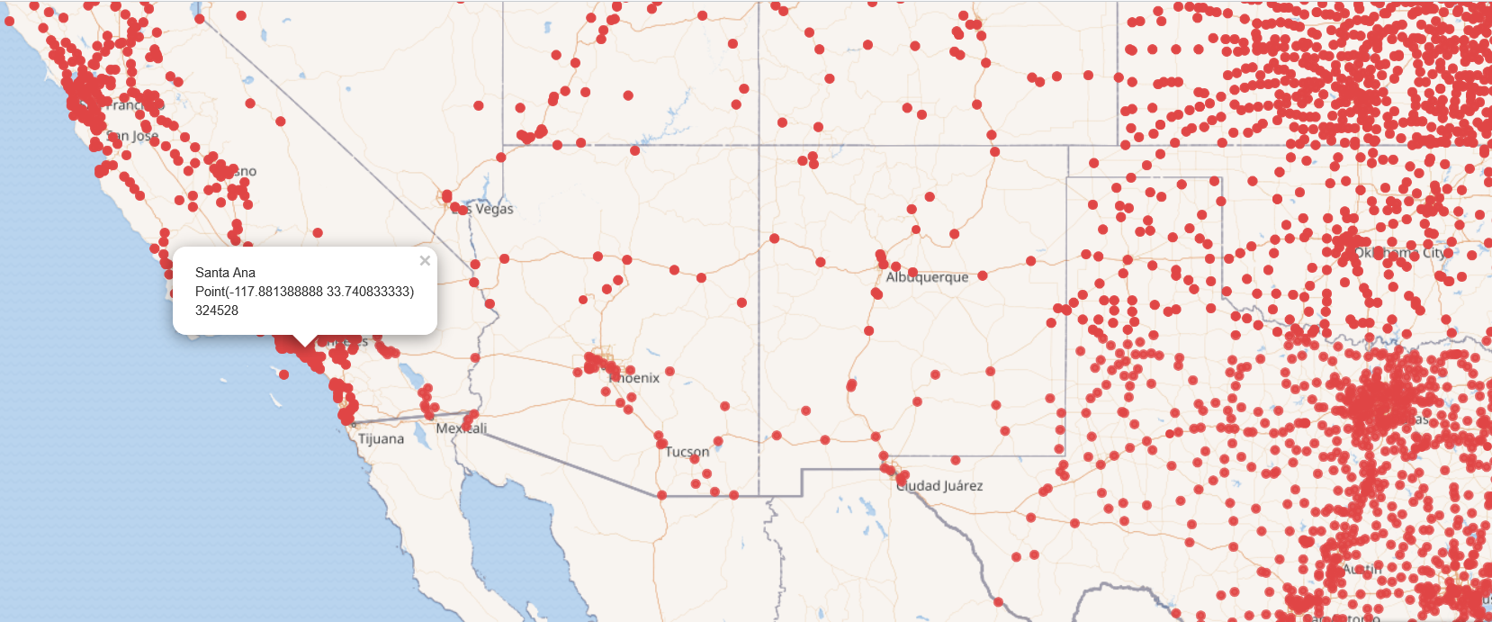
Plotting geospatial results

Slide 48
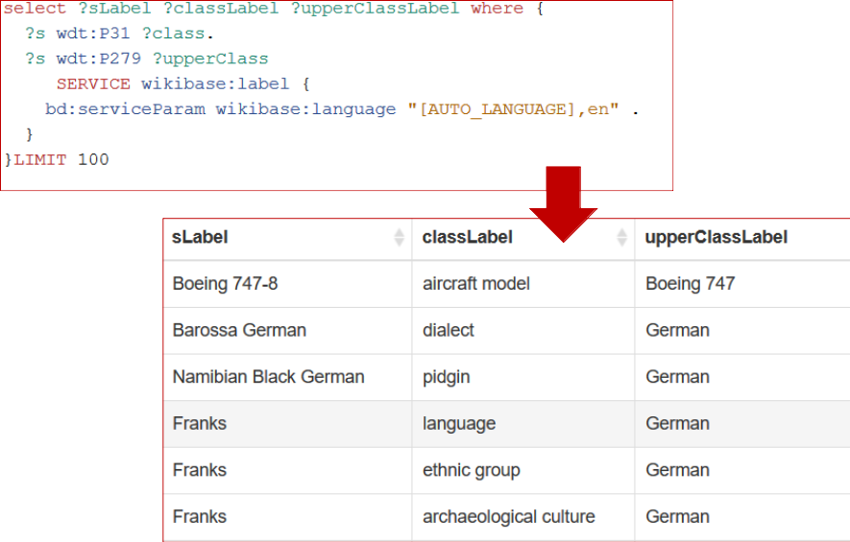
Querying the taxonomy
Entities can be classes and instances in Wikidata

Slide 49
Summing up...

Slide 50

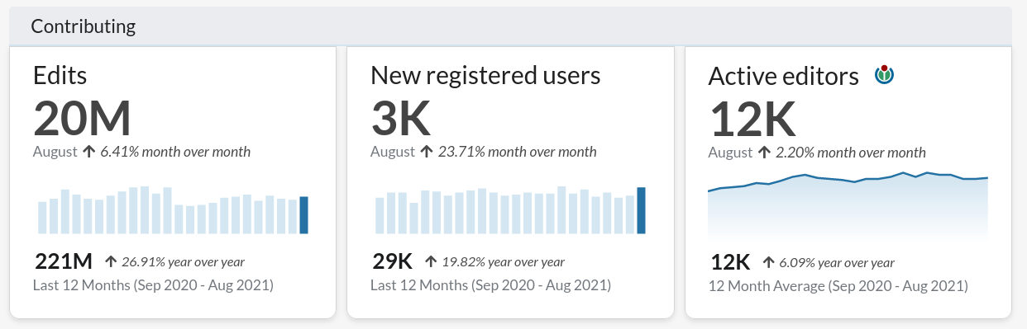
Summary
Wikidata is a large Knowledge Graph
Free
Collaborative
Multilingual
A secondary database
Collecting structured data
Support for Wikimedia wikis
Anyone in the world
With many applications
A thriving community of contributors
> 99M items
> 6,000 properties
> 2,000,000 classes
> 4,000 external id types
Awesome SPARQL endpoint

Slide 51


THANK YOU FOR ATTENDING
Submit a webinar proposal at https://www.asist.org/meetings-events/webinars/
webinars@asist.org
A copy of the recording and a follow-up survey will be emailed within 24 hours.

Slide 52
Architecture of Wikidata

Slide 53
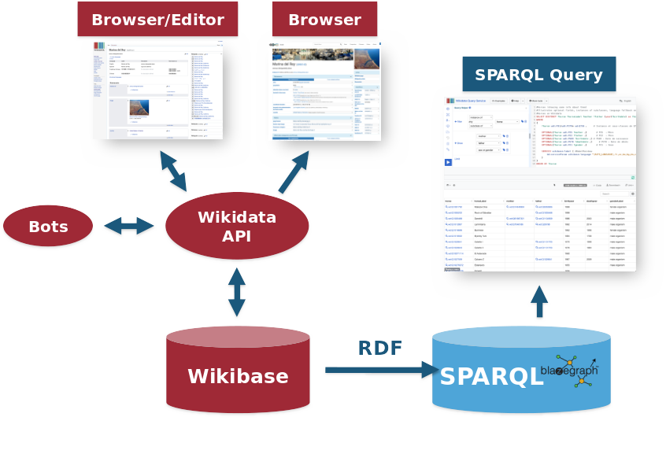
Architecture of Wikidata

Slide 54
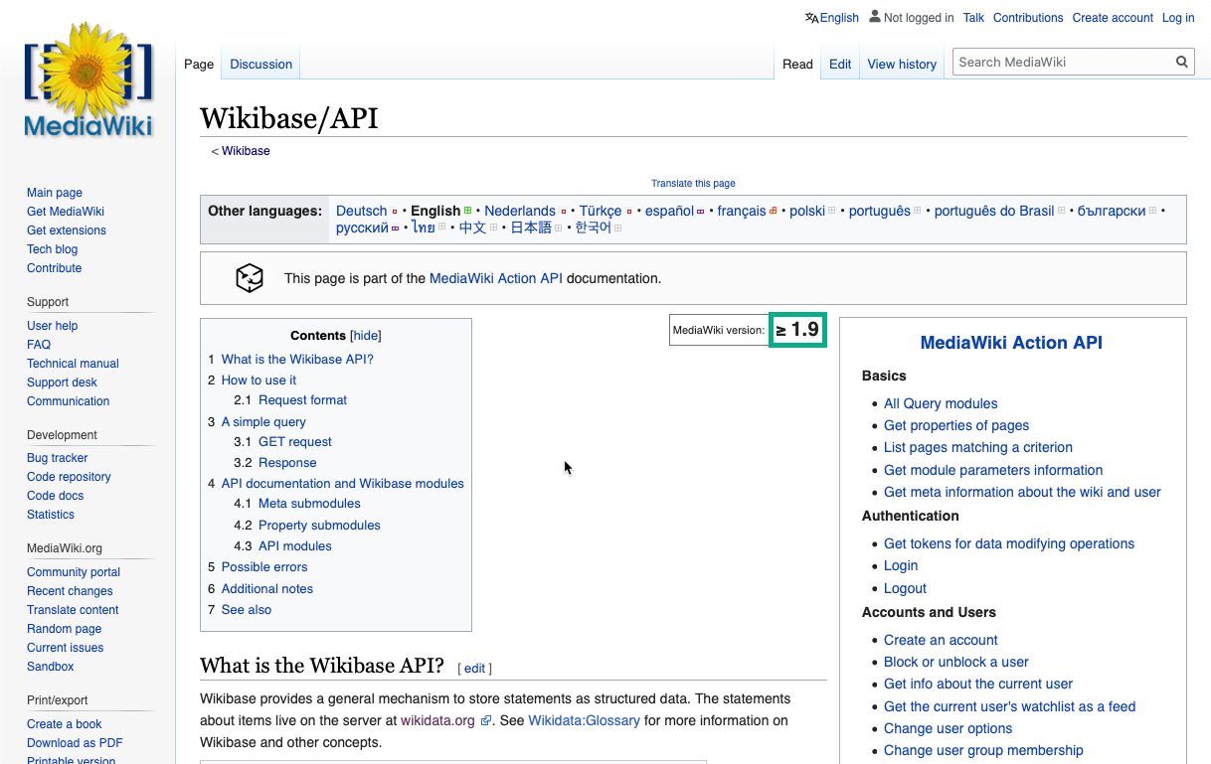
Wikibase API
https://www.mediawiki.org/wiki/Wikibase/API
Revision history of every page

Slide 55
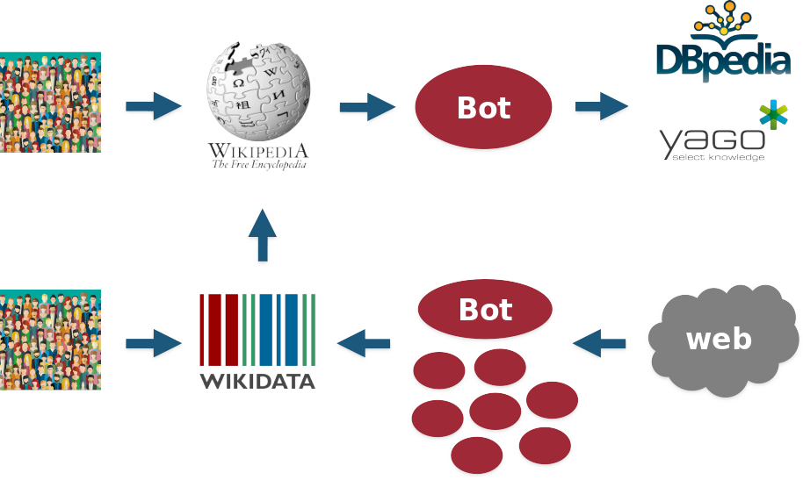
Wikidata versus other Knowledge Graphs

Slide 56
Applications for managing Wikidata

Slide 57
Existing tools: overview
Edit data
Help editing content, quality assurance, finding duplicates
Query data
Completeness, natural language support, linked items
Improve user interface
Hovering, enhanced search, summaries, keywords
Visualize data
Maps, graph charts, etc. from queries
Working with the schema
Find properties, classes
Lexicographic
Lexeme forms and building, term sensing
Tools for programmers
Manipulate Wikidata answers in JSON
Find all tools at: https://www.wikidata.org/wiki/Wikidata:Tools (Some are Wikibase gadgets)

Slide 58
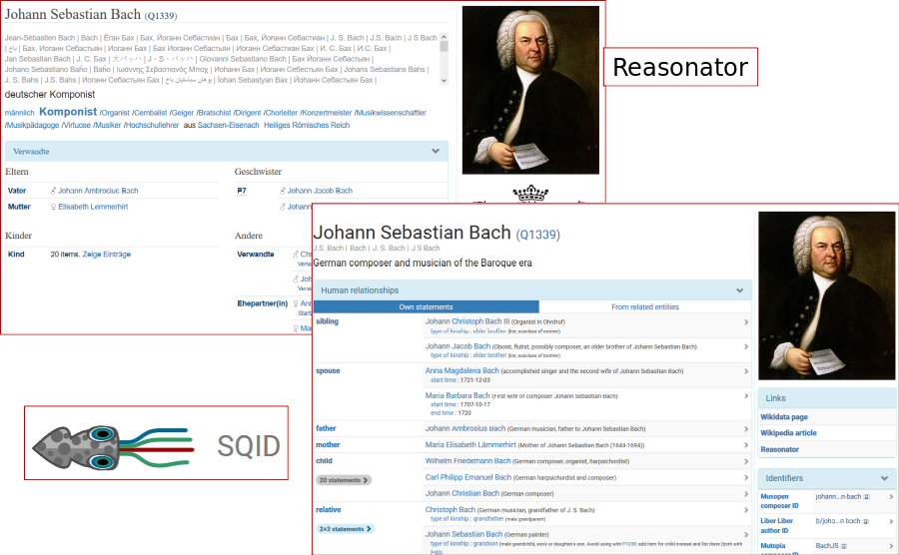
Browsing tools

Slide 59
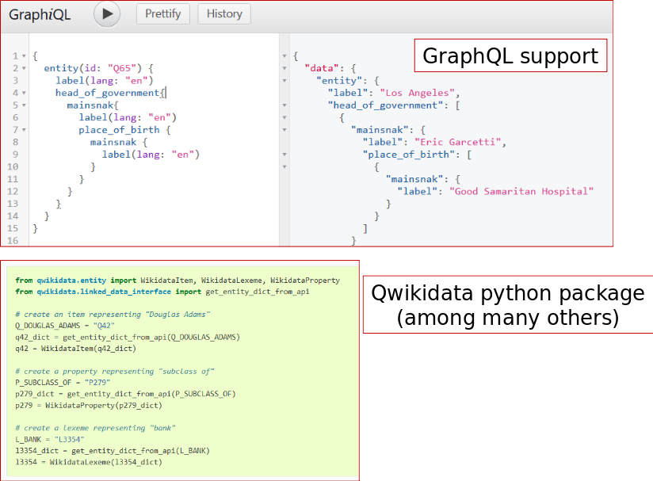
Expert tools

Slide 60
Other queries to play around
Spanish political parties / Partidos políticos españoles
https://w.wiki/YJA
You will see that we also need to refer to other types of ”political parties”, such as electoral coalitions
Politicians that belong to Spanish political parties / Políticos que pertenece a partidos políticos españoles
https://w.wiki/YJJ
Sports / Deportes
https://w.wiki/YJK
Spanish Football Teams / Equipos de fútbol españoles
https://w.wiki/YJL
Positions held by Pedro Sánchez / Cargos ocupados por Pedro Sánchez
With their beginning and end https://w.wiki/dNV

Slide 61
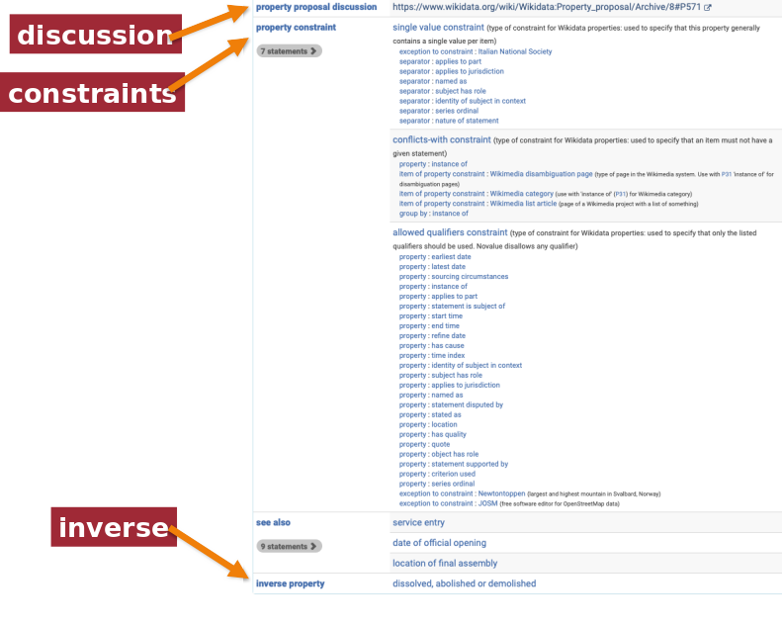
Property axioms

Slide 62
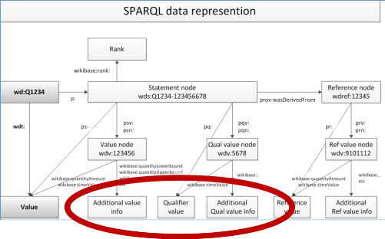
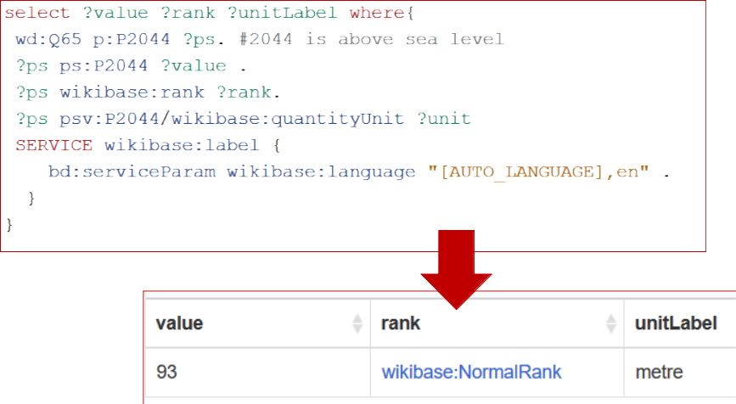
Units
What is the elevation above sea level in LA?
Link to query: https://w.wiki/CFs

Slide 63
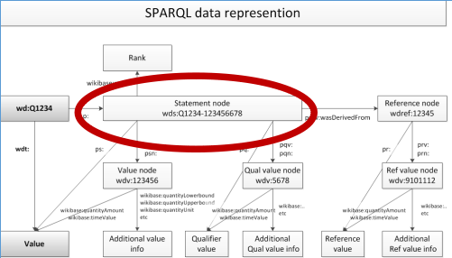
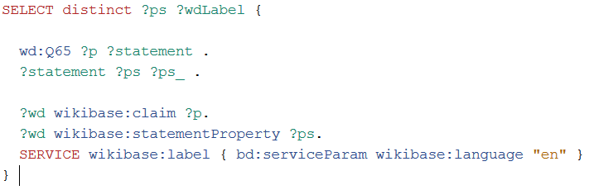
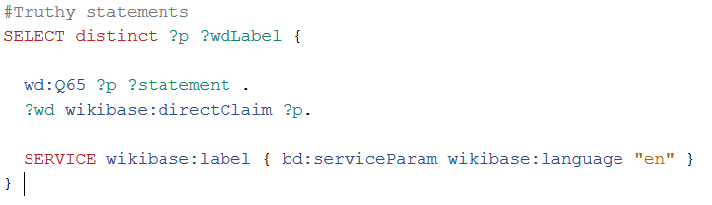
Property metadata
Retrieving information about all properties used to describe LA (Q65)

