Slide 1
Introduction to Metadata Application Profiles
DCMI Webinar
Karen Coyle
2018

Slide 2
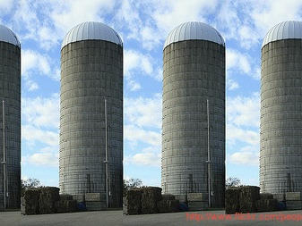
Data silos
Notes:
We' e all gotten the message about data silos and how bad they are. They prevent data sharing, they keep us from taking advantage of the work of others.

Slide 3
Data silos
DC
DC
BIBO
MARC21
Notes:
We think of data silos as being the result of using different standards or different data formats.

Slide 4
Data silos
MARC21
MARC21
MARC21
MARC21
Notes:
But just because we use the same basic standard, it doesn't mean that we are producing identical data. As anyone who has tried to consume data from another institution or project knows, there are always local variations – variations in which fields or terms are used, variations in how the data has been recorded. Even when we think we are not creating data in a silo, in many cases we are. It's difficult to avoid have your data be your data.
I'm going to talk about how application profiles can help with data sharing and data reuse.

Slide 5
What are application profiles?
Record your institution or project's choices
Form a basis for developing a consensus around your own data
Express specific practices, rules
Tell data consumers what to expect
Notes:
They are many things

Slide 6
Why do we need them?
How can someone else understand your data well enough to make use of it?
Not unlike open source problem: you can declare your code ‘open’ and wish people ‘good luck’ or you can provide support.

Slide 7
Who needs them?
Creators: anyone providing data
Users
anyone who can/is allowed to access the data
both people AND machines - not an either/or, but should be both
Notes:
Rather like the schema.org focus in terms of data providers = anyone with data on the web.
These folks are not always coders, and may have experience limited to a only a few technologies. Any solution has to fit into their toolbox; we can’t require them to re-tool to use this solution.

Slide 8
What are they?
Basic structure of the data
the story that the data tells; what you are trying to say
what are the things? how are they described?
What are the properties and the rules for property use?
What are the values?

Slide 9
How are they?
What will a profile be? How can it be implemented?
Documents (PDF)
Spreadsheets
Code (RDF, JSON, XML)

Slide 10
What does an application profile look like?
Notes:
Today there is no standard format for application profiles

Slide 11
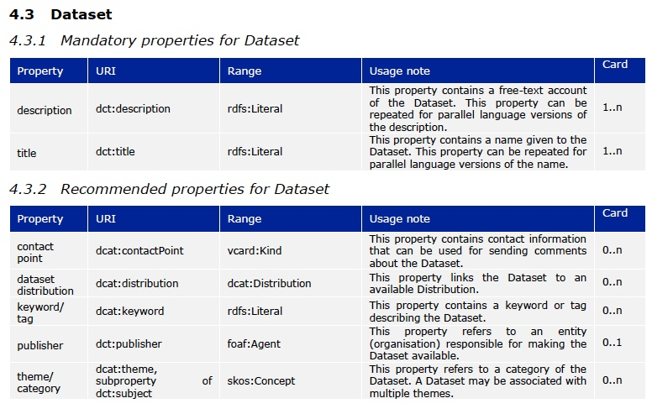
Notes:
Profiles exist today, and take many forms. This is an example of a profile based on the Dataset Catalog (DCAT) vocabulary. There a number of different application profiles based on this vocabulary, which is was developed to support government open data in the European Union, although it also used elsewhere. Many countries have created application profiles that are specific to their country because they each had some specific needs. Those choices are recorded in the application profiles which generally take the form of documents.

Slide 12
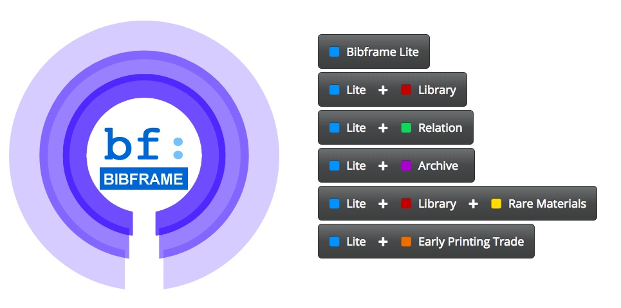

Slide 13
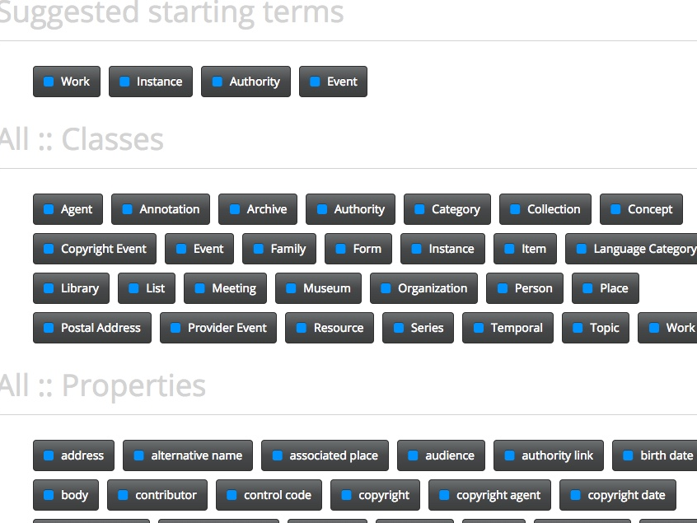
Notes:
This is a profile based on the BIBFRAME vocabulary.

Slide 14
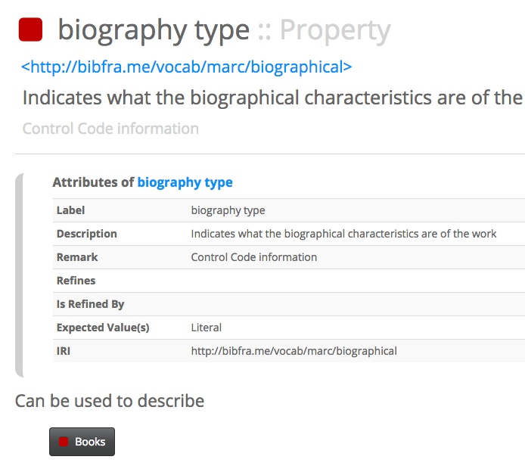
Notes:
There is information about each term, including what type of value is expect (whether it will be a URI for a thing or will be text).

Slide 15
Dublin Core and Application Profiles
Notes:
Dublin Core has had the ide aof application profiles since the late 1990s. This fits in well with the fact that DC is intended as a highly reusable vocabulary that can fit many different situations and needs.

Slide 16
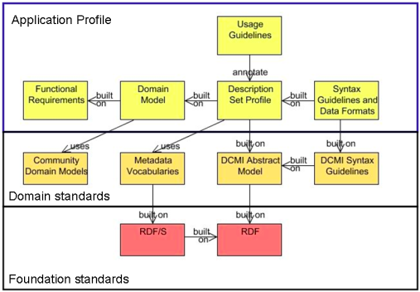
Dublin Core Singapore Framework for Application Profiles (2007)
Notes:
First in 2007. In keeping with the use of the place name to name things, this was first presented in Singapore.

Slide 21
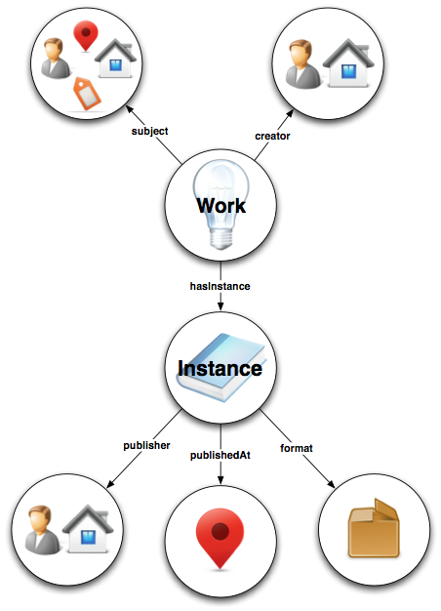
Domain model

Slide 22
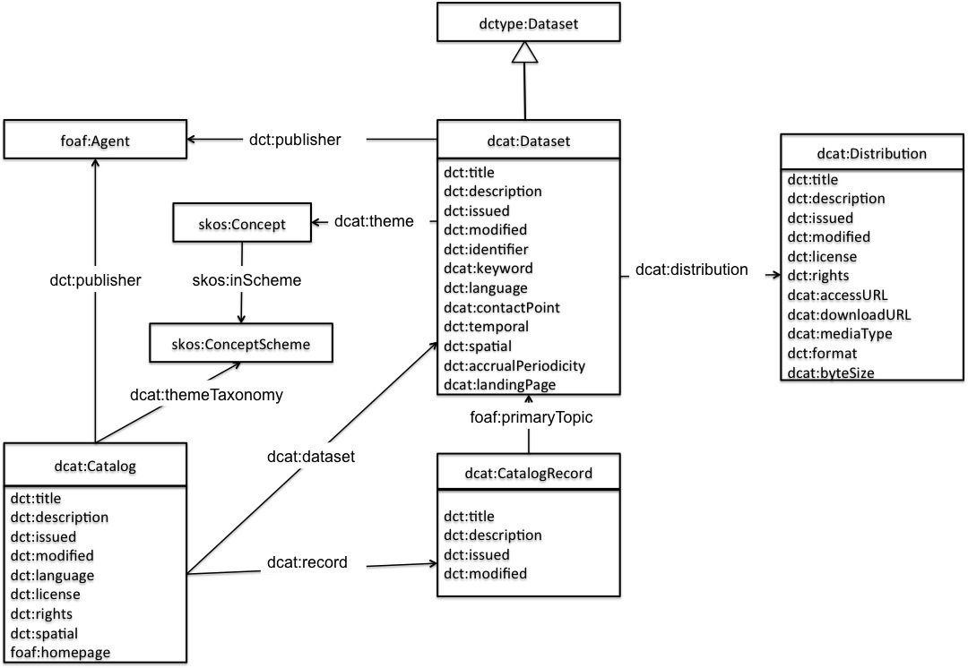
Domain model
Notes:
It's the picture that you have in your head that tells you what aspect of the world your data covers, what are the "parts" or entities that make up your description of that world, and how the parts fit together.
Domain models can vary in their complexity and detail, and may have different levels of detail depending on the view that is needed at some moment in time.

Slide 24
Functional requirements
Before developing any solutions, define problems
Decide which problems you can solve
State the requirements for success

Slide 26
Notes:
This is the digital format of your profile – PDF, XML, etc.

Slide 27
Vocabularies
Profiles reuse vocabularies
Profiles can select from a single vocabulary
Profiles can extend a vocabulary
Profiles can combine vocabularies
Notes:
Profiles generally are a reuse of vocabularies.
Like BIBFRAME, the profile can be a selection from a single vocabulary. In this case the profile's message is: I am a profile of BIBFRAME. I use some but not all of the BIBFRAME-defined vocabulary.
Profiles can make use of all or part of a vocabulary, but can add terms that they need but that are missing from the base vocabulary. This is the case with the DCAT profiles: they are based on the DCAT vocabulary, but in some cases the users of DCAT needed to add some information that was not covered by that vocabulary. If you have worked with the Europeana Data Model you may be familiar with profiles that have some Europeana elements but that also add their own terms or equivalents. The DCAT profiles have much overlap between them but each one has information that is not included in DCAT.
But profiles can also be not related to any single vocabulary. They can be a mix and match that essentially creates a new vocabulary. Oftentimes these vocabularies are not treated as profiles, and the line between a new vocabulary made up of existing terms and a profile is not distinct. We can say, however, that a profile does not have to be primarily based on any one vocabulary. Even Europeana and DCAT vocabularies make use of terms from Dublin Core,

Slide 29
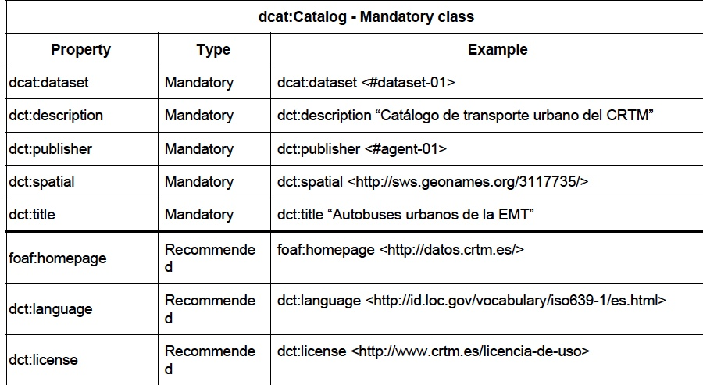

Slide 30
Term reuse & semantics
Reuse can narrow semantics but should never contradict how the term is defined at its origin
Terms with strict definitions (e.g. OWL constraints, limits on valid values, disjoint with other terms) are the hardest to reuse
Base vocabularies are best if they employ minimum semantic commitment
Notes:
You have to pay attention to how a term is defined before you reuse it.

Slide 32
Components of a profile
Vocabulary
Definitions
Usage rules
Cardinality of terms and values
Examples
Validation rules
This is not a full list!

Slide 38
Notes:
Examples

Slide 39
Validation rules
Can have foaf:name or (foaf:foreName + foaf:familyName)
dct:date cannot be > 2020
Subjects must be from http://id.loc.gov/authorities/subjects/

Slide 40
Validation
Non-RDF (e.g. XML schema)
SHACL – W3C recommendation (SHApes Constraint Language)
https://www.w3.org/TR/shacl/
ShEx – W3C community group (Shape Expressions)
http://shex.io/

Slide 41
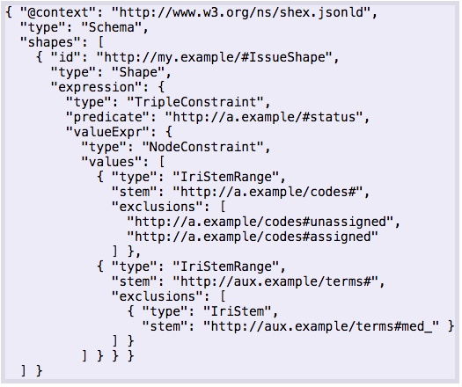
Validation
Non-RDF (e.g. XML schema)
SHACL – W3C recommendation (SHApes Constraint Language)
https://www.w3.org/TR/shacl/
ShEx – W3C community group (Shape Expressions)
http://shex.io/
Notes:
The problem is the validation code usually is pretty complex. This is an extremely simple example that say that my property "status" can be one of two things: "assigned" or "unassigned". So you an imagine how much code it takes to say something much more complicated.
It isn't reasonable to assume that everyone who creates metadata is capable of writing the needed validation code.

Slide 42
Not everything can be validated
"Recommended" "Mandatory if applicable"
Names, resource titles, other string-based data
Notes:
There are a lot of things in data that cannot be validated, especially for those in the cultural heritage area where much of there metadata consists of text, and is based on decisions made by human beings, not on calculations. So although validation is important, validation alone won't describe a profile.

Slide 43
Maintaining profiles

Slide 44
Profile maintenance
Who maintains the profile?
How will new terms be added?
What can be changed?
How can the profile be extended?
Notes:
These are community decisions. If you do not include in your development of profiles the means to maintain and evolve the profiles, within a short time they cease being living solutions to your metadata needs.
https://pro.europeana.eu/project/creation-and-governance-of-edm-mappings-profiles-and-extensions-task-force
http://makxdekkers.com/DXWG/DCAT-AP.pdf

Slide 45
What we need so that we can (easily) create profiles

Slide 46
Some profile-related efforts
Dublin Core (since the late 1990's) based on Singapore Framework
http://dublincore.org/documents/singapore-framework/
http://dublincore.org/documents/profile-guidelines/
DXWG – Data eXchange Working Group, W3C, application profile guidance (2017, due 2019)
https://www.w3.org/2017/dxwg/wiki/Main_Page
Notes:
Just to mention here that I am co-chairing the W3C group representing DC. That group will be creating a kind of "best practices" document but nothing so specific as code. The Dublin Core work is more detailed, but has not yet yielded a usable schema for profiles. Hopefully that is in progress.

Slide 47
Standard profile language(s)
Core for the simplest needs, or for getting started
shows domain model
lists vocabulary terms
can express basic rules for vocabulary members, especially cardinality & values
documentation for human readers

Slide 48
Generic domain model - DC
Profile
Resource
"things"
Property
"terms or elements"
Value
"data"

Slide 49
MyBookCase
Profile: MyBookCase
Resource: Book
Resource: Person

Slide 50
MyBookCase
Profile: MyBookCase
Resource: Book
Property: title
Property: author
Property: size
Resource: Person
Property: name

Slide 51
MyBookCase
Profile: MyBookCase
Resource: Book
min:1
max:1
Property: title
min:1
max:1
Property: author
Property: size
Resource: Person
Property: name
Notes:
This looks like an entity-relation diagram at this point. But more is needed.

Slide 52
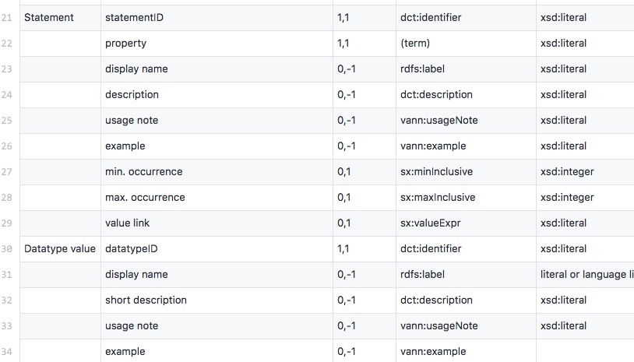
Notes:
In a sense, an application profile for an application profile. Not yet "finished", but may demonstrate that we can use something as simple as a spreadsheet to allow people to easily create application profiles that can be converted to a form that would allow for ingest and validation. All without the metadata schema creator having to write code.
Note in particular that very few of the elements here are required. (Those with an initial zero in the third column are optional.) An application profile could be simply a list of terms that are used for one or more resources, with a resource being a document, a person, a place, a subject. Whatever you want it to be.

Slide 53
Notes:
Profiles need to give helpful information for humans, as well as having the basic structures that can be used to aid metadata creation and metadata consumption.

Slide 54
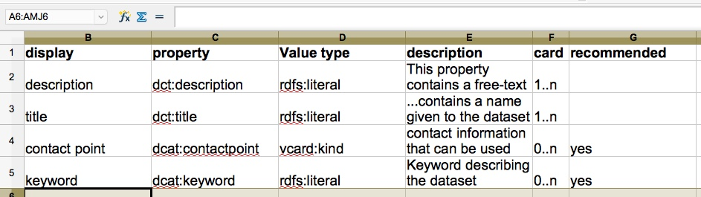
APs as spreadsheets?
Notes:
Spreadsheets – which then become CSV files (comma separated files).

Slide 55
Can we make validation "easy"?
Valid properties ✔
Valid values ✔
Value types
Value lists (text or URIs)
Conditional rules 
If A not B
A or (B & C)
Notes:
It would be ideal to be able to express all of the rules that would be necessary to validate your data. That can get to be quite complex.

Slide 56
Validation – bridging the gap
Profile may need validation pseudo-code
Pseudo-code -> code?
What to do with non-actionable statements of validation (“mandatory if applicable”)?
Notes:
Can we include in this simple view of profiles an easy way to include validation rules, or at least the most basic validation rules? That would go a long way to aiding interoperability of datasets.

Slide 57
Summary: Functions of a profile
Consensus-building
Documentation
Input/output control
Validation (input and output and sharing)

Slide 58
Thank you
kcoyle@kcoyle.net
https://github.com/kcoyle/RDF-AP

